Slide 1


SAP UI5 & FIORI with OData TRAINING
Anubhav Oberoy & Nishan Nainsukha
Day – 18

Slide 2

Agenda – Day 18
BAS Fiori App Integration with OData
Consuming Northwind OData Service
Fiori System Architecture
Fiori App Reference Library
Two types of SAP-Fiori App Implementation
ABAP deployment
Pre-requisites for Standard Fiori App
SAP Fiori Standard App Implementation
Relationship between Front-End Components
Trainer: Anubhav Oberoy & Nishan

Slide 3
BAS Fiori App Integration with OData
Step1: Create xs-app.json file in your project folder.
{
"welcomeFile": "/index.html",
"authenticationMethod": "none",
"routes": [
{
"authenticationType": "none",
"csrfProtection": false,
"source": "^/sap/opu/odata/sap/Z_FIRST_XX_SRV/",
"destination": "CFN"
},
{
"source": "^(.*)$",
"target": "$1",
"service": "html5-apps-repo-rt"
}
]
}

Slide 4
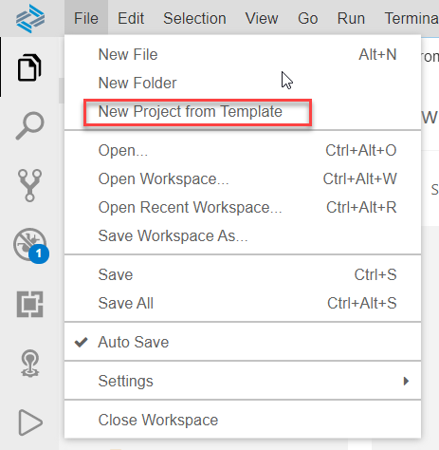
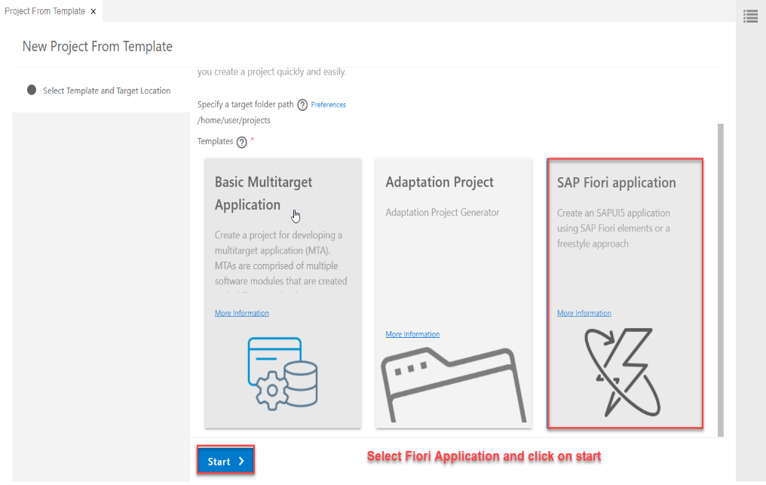
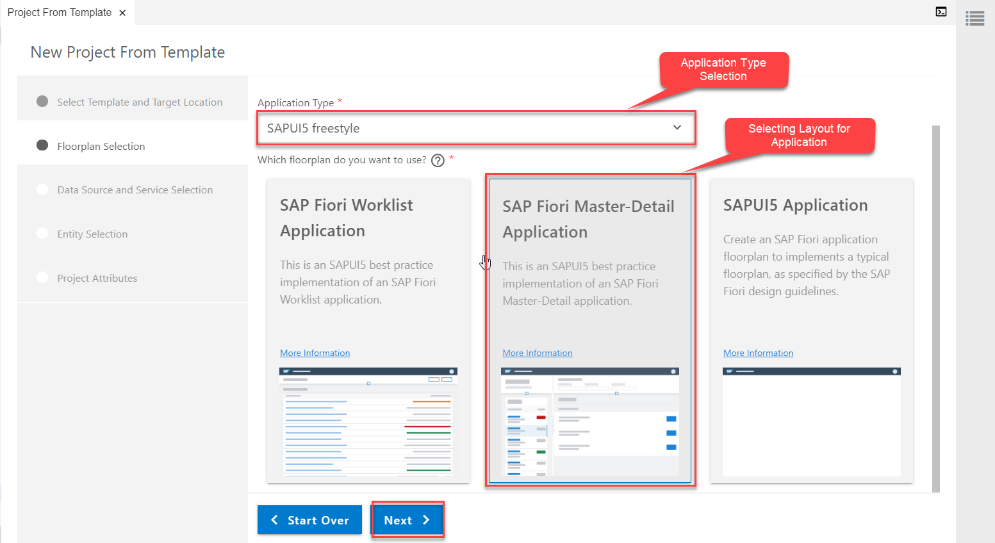
Consuming Northwind OData service
Creating a Fiori Application From Template which Consumes Northwind OData service
Step1: Starting Project from Template
Project From Template
Template Selection (Fiori Application)
Application Type & Layout

Slide 5
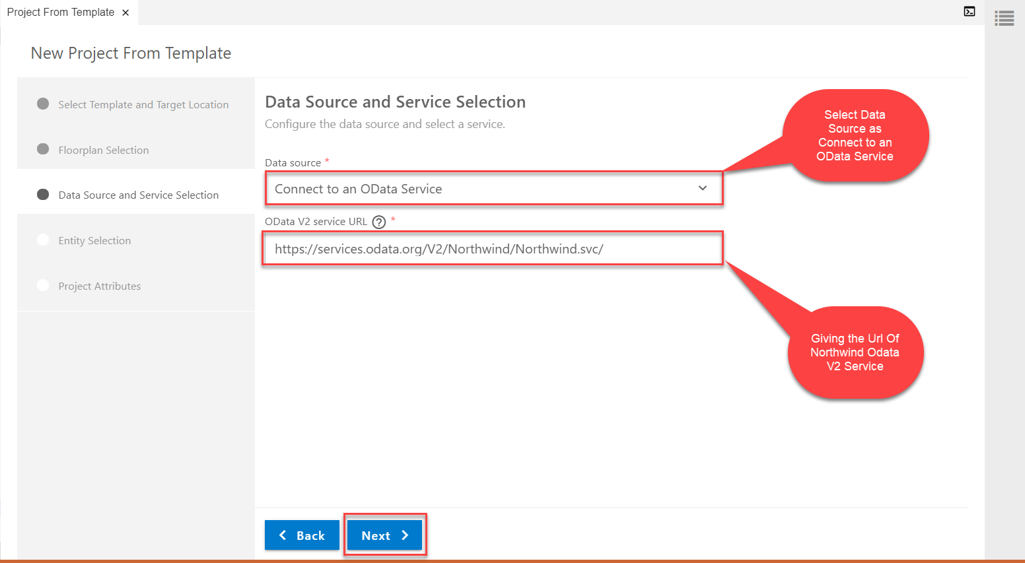
Consuming Northwind OData service
Step2: Data Source and Service Selection
service url: https://services.odata.org/V2/Northwind/Northwind.svc/

Slide 6
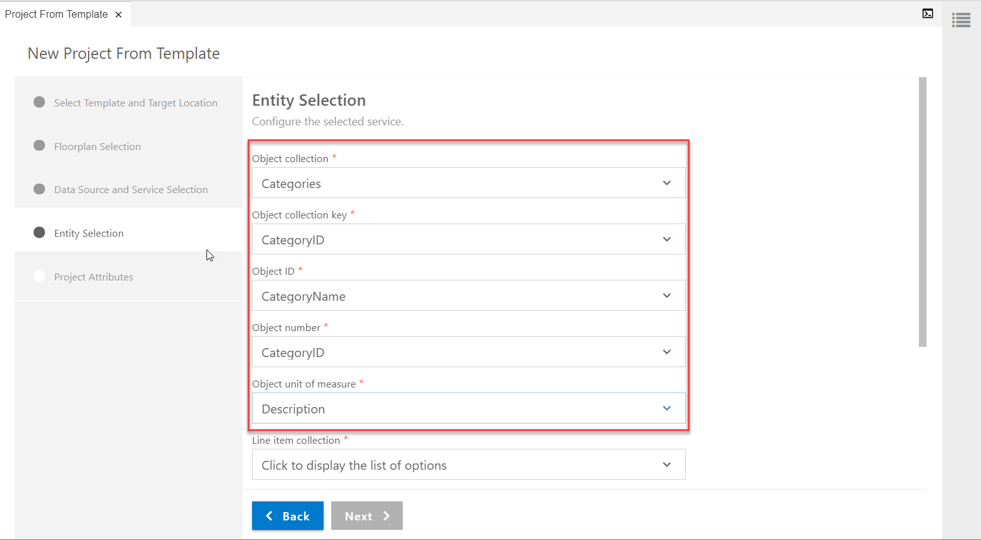
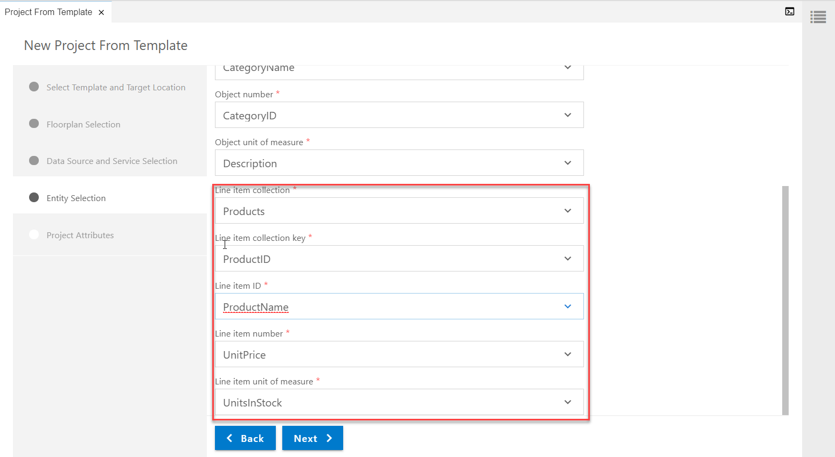
Consuming Northwind OData service
Step3: Entity Selection
3.1 Object Selection(to be viewed in Master Page)
3.2 Line Item Selection (to be viewed in Detail page)

Slide 7
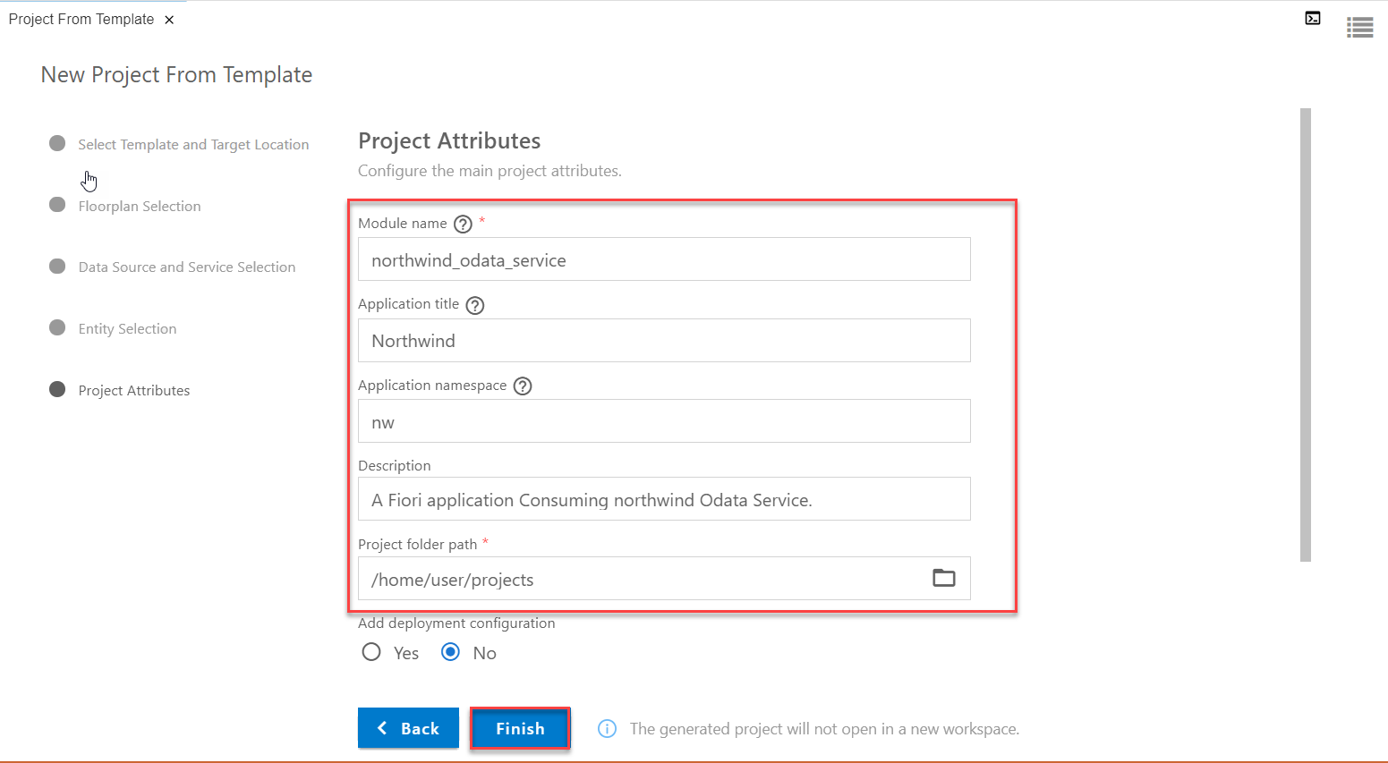
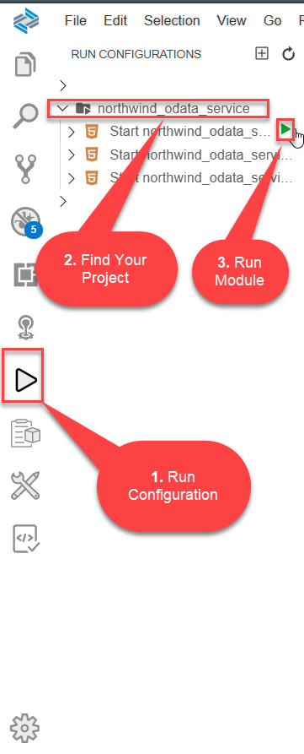
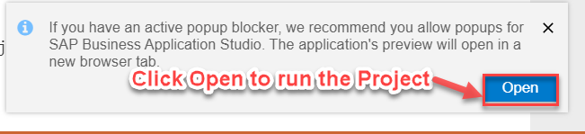
Consuming Northwind OData service
Step4: Finalizing the Project
Step5: Run the project from Run Configuration

Slide 8
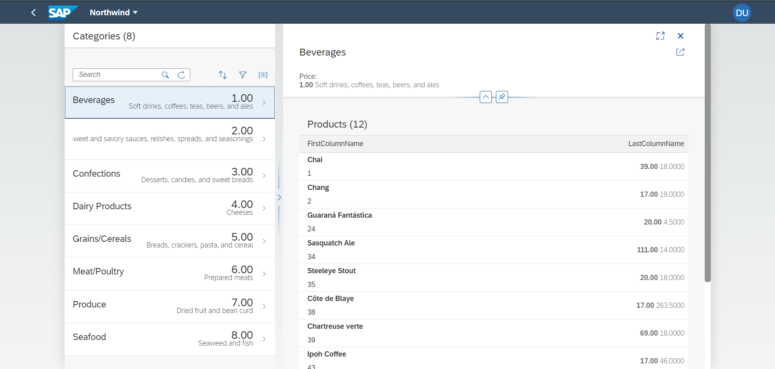
Consuming Northwind OData service
Final Project With Northwind OData Services (i18n File)

Slide 9
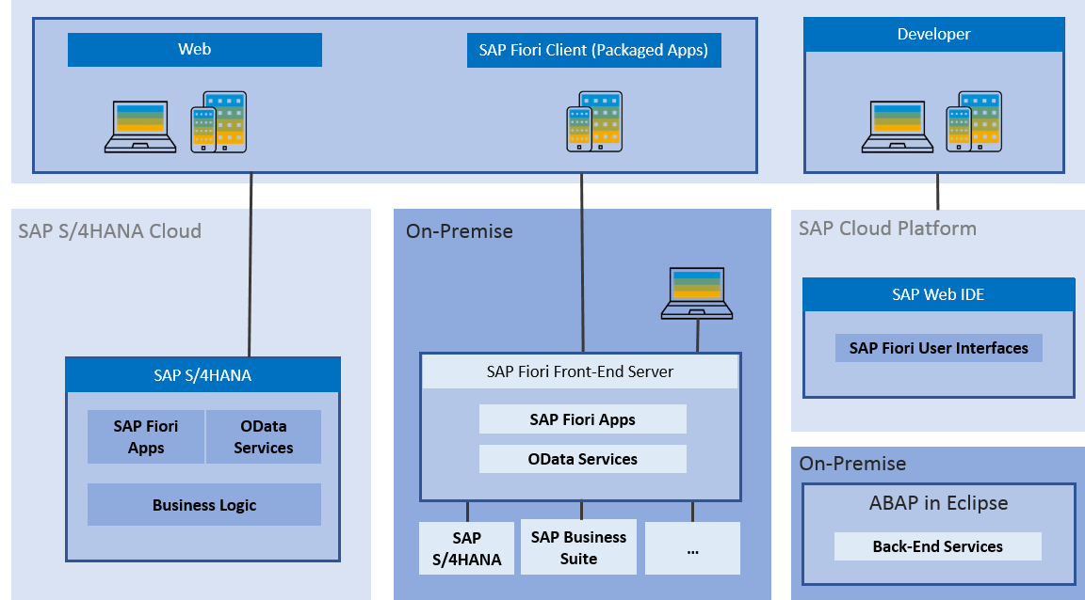
Fiori System Architecture
The SAP Fiori architecture introduces the high-level architecture of SAP Fiori.
The SAP Fiori apps are built with SAPUI5 technology for web applications and iOS native and can be used on smartphones, tablets, and desktop computers.
The SAP Fiori launchpad is used to launch and run the apps.

Slide 10
Fiori App Ref. Library
It’s a library which tells us all the list of Fiori Apps and Non-Fiori Apps offered by SAP as standard.
These apps are grouped under solutions and we can search particular app(s) based on different criteria
https://fioriappslibrary.hana.ondemand.com/sap/fix/externalViewer/
Total Apps – 11628
Fiori Apps - 2107
By Name, description
By User function
By Id & Product
By Functional
Area – Finance, Sales, Marketing, Procurement
By Role
Different Search Criteria

Slide 11
Two types of SAP-Fiori app implementations
Standard Apps
Implementation of those business apps, which are released by SAP
These are categorized as Transnational, Fact-sheets and Analytical apps etc.
Customized Apps
As per business requirement, a complete custom fiori app can be implemented.
Customized App is been hosted on SAP-Fiori server (front-end system).
It integrates with SAP or Non-SAP system.

Slide 12
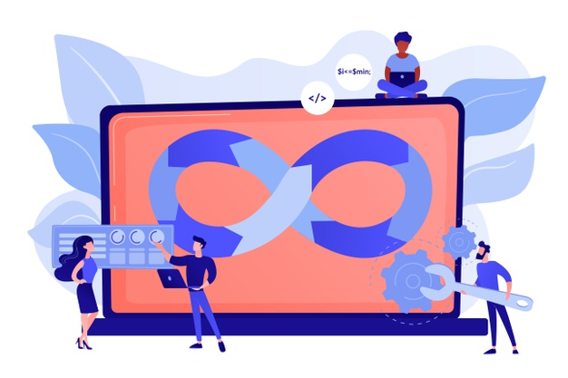
ABAP Deployment
Step1: Open the terminal in BAS and go to your project folder.
Step2: Write command ui5 init and press enter
Step3: Write command ui5 build and press enter
Step4: Write command abap-deploy and press enter
Step5: Specify the source folder path for deployment … ./dist
Step6: Select a target ABAP system … http://103.207.171.202
Step7: Enter the ABAP system client number …
Step8: Enter a username …
Step9: Enter a password …
Step10: Enter an application name …
Step11: Enter a description for the application …
Step12: Enter a package for the deployed application … $TMP

Slide 13
Pre-requisites for Standard Fiori App
SAP ECC Server (Back-end)
SAP Fiori Server (Front-end)
SAP Fiori Launchpad Url:
http://<host>:<port>/sap/bc/ui5_ui5/ui2/ushell/shells/abap/FioriLaunchpad.html
tcode: /n/ui2/flp
SAP Fiori Designer Url:
http://<host>:<port>/sap/bc/ui5_ui5/sap/arsrvc_upb_admn/main.html
tcode: /n/ui2/flpd_conf
Important T-codes:
SrNo | T-code | Description
1 | SICF (Path: /sap/bc/ui5_ui5/sap/) | UI5 Application Path
2 | SICF (Path: /sap/opu/odata/sap/) | Odata Service Path
3 | /n/iwfnd/maint_service | Odata Service Registration
4 | /n/UI2/SEMOBJ_SAP | Semantic objects by SAP
5 | /n/iwfnd/error_log | Error Log
6 | LPD_CUST | Launchpad Role
7 | PFCG | PFCG Role

Slide 14
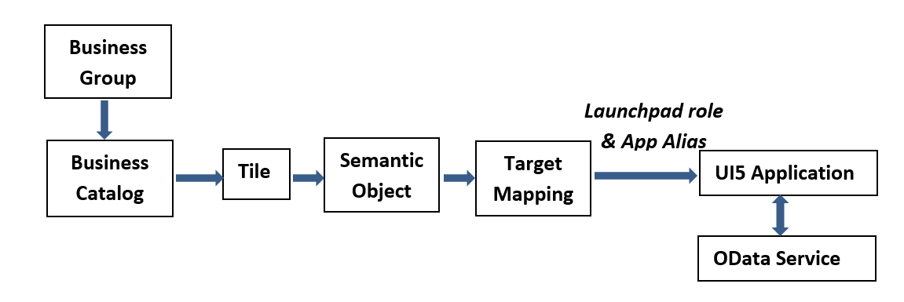
Relationship between Front-End Components

Slide 15

End of Day 18

Slide 16

Questions

Slide 17

Anubhav Oberoy

Slide 18


We’re committed to empower you to be
Most Desirable Resource
through powerful training solutions.
We build the workforce of the future.
250+
Corporate Clients
30,000+
Learners Trained
25000+
Learners Placed
FREE WEBINARS
Sign up for free webinars with industry experts every fortnight!
Enroll Now!
Contact us today!
https://anubhavtrainings.com/

Slide 19




More from AnubhavTrainings.com

